Slide 1
Blind estimation of acoustic transfer functions (ATFs) and dereverberation based on convolutive transfer functions (CTFs) Date：2024. 04. 17
Telecom Electroacoustics Audio(TEA) Lab
Presenter:
Anchi Yuan
Notes:
Hello everyone
I’m today’s presenter siang. I’m going to share some of my present work in source separation problem. My topic is comparative studies of source separation using semi-blind and blind source separation approaches.

Slide 2
Outline
Localization procedure
Golden section search method (GSS)
Simulation setting
Simulatio result

Slide 3
Localization procedure
Freefield plane wave model for angle-wise localization
Check array output power has global minimum or not
Array output power as objective function for golden section search method (GSS)
Freefield plane wave or point soure model for distance-wise localization
Predicted RTF with given distance
Generate freefield plane wave RTF
Cosine similarity as objective function for golden section search method (GSS)

Slide 4
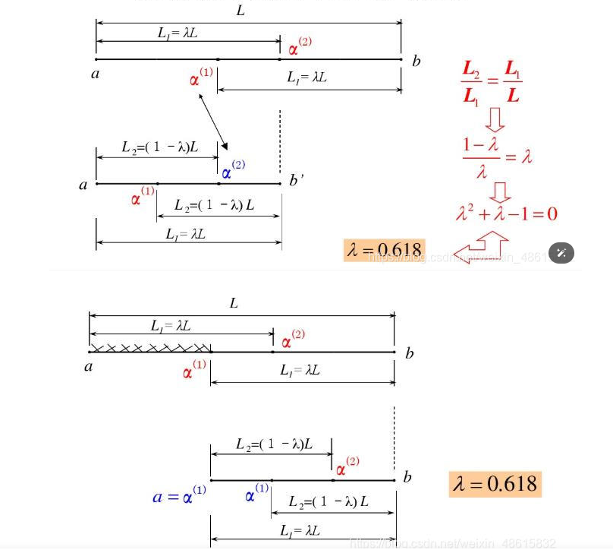
Golden section search (GSS)

Slide 5
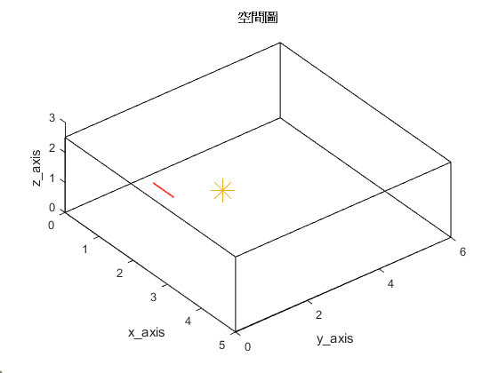

Simulation settings
Uniform linear array (ULA)
Number of microphones = 6
Spacing = 0.02m (2cm)
Aperture = (6-1)*0.02 = 0.1 m
Room size = 5m $×$6m $×$2.5m
Sampling frequency = 16kHz
Reverberation time T₆₀ = 0.2s
First microphone location [1, 1.5, 1]
2.5m
origin
Source location [2, 2.6, 1]
5m
6m

Slide 6
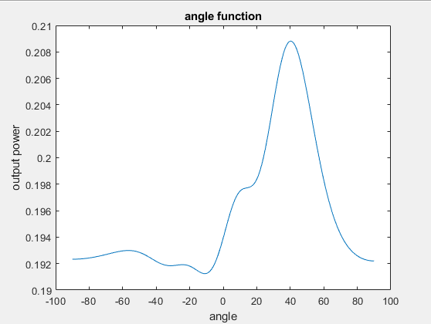
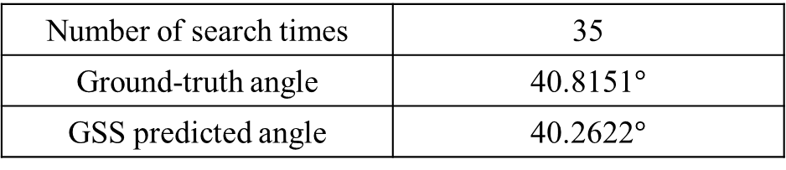
Simulation result
Output power as function of angle
Number of search times | 35
Ground-truth angle | 40.8151$°$
GSS predicted angle | 40.2622$°$

Slide 7
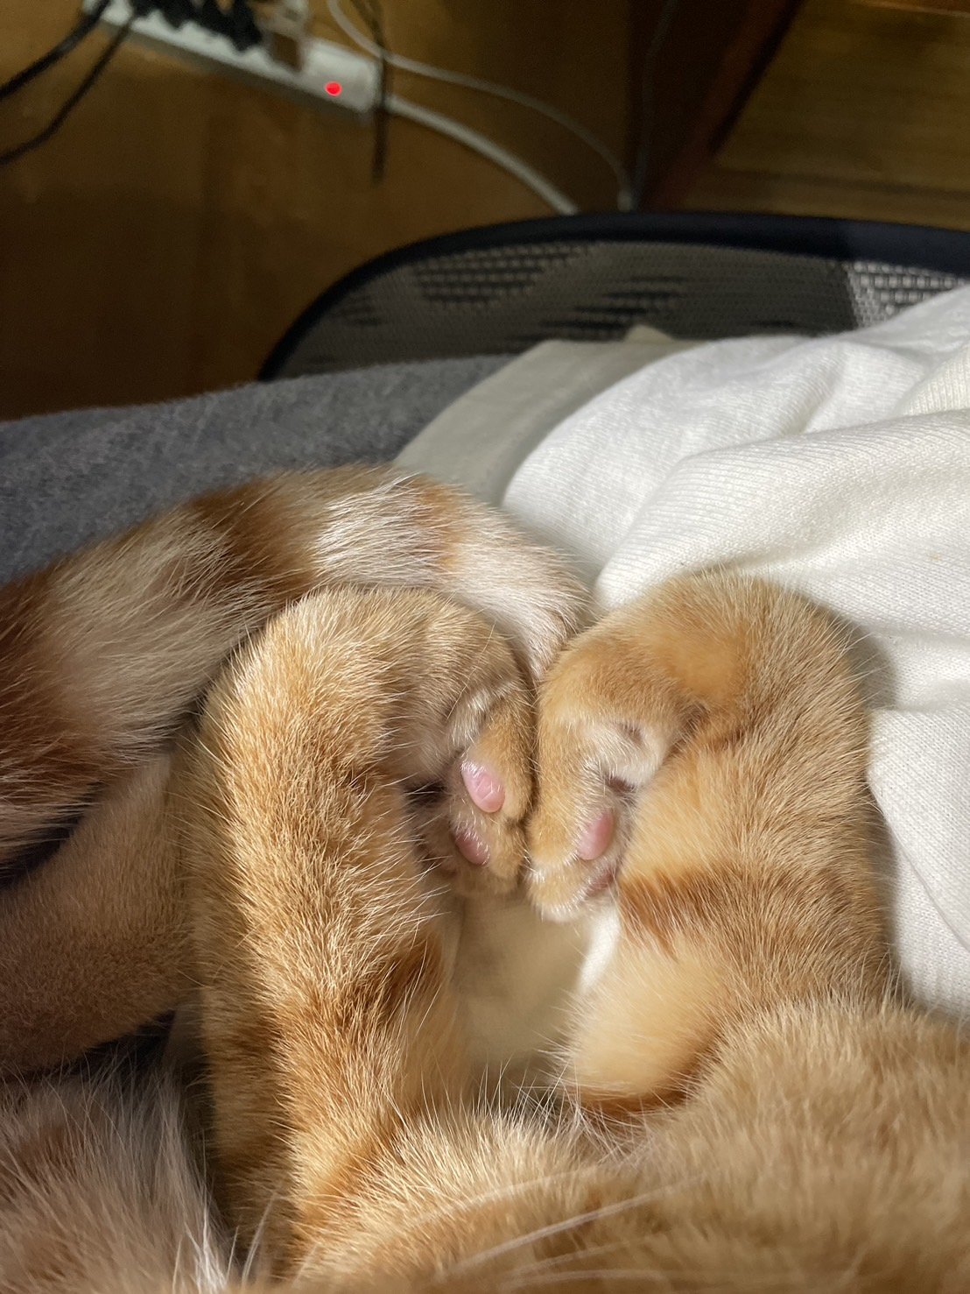


Slide 8
Simulation result
Ground-truth distance | 1.4534m
GSS predicted distance

